Slide 1

EyeGuard-XAI Reliable & Explainable Retinal Disease Screening System
Group Members
Talha Hanif (22P-9051)
Muhammed Usman (22P-9071)
Project Supervisor
Muhammad Zulqarnain

Slide 2
Introduction
Retinal diseases (DR, Glaucoma, AMD) are major causes of preventable blindness.
Early screening using fundus images reduces vision loss risk.
Deep learning enables automated detection but behaves as a black-box.
Existing solutions prioritize accuracy over reliability and usability.
EyeGuard-XAI integrates explainability, uncertainty, and user-centric design.

Slide 3
Problem Statement
Current retinal disease detection systems suffer from overconfident predictions without uncertainty awareness, poorly calibrated confidence scores, and black-box decision-making that reduces clinical trust. Additionally, many existing solutions focus on single-disease detection and lack adaptive interfaces for both doctors and patients—creating a gap for a reliable, explainable, and user-centric intelligent eye diagnosis system.

Slide 4
Solution
Multi-disease retinal screening using CNN (ResNet/EfficientNet).
Monte Carlo Dropout for predictive uncertainty.
Calibration using Expected Calibration Error (ECE) & temperature scaling.
Grad-CAM heatmaps for visual explainability.
Dual interface: Doctor (detailed) & Simple User (risk-based).
Educational chatbot for awareness and guidance.

Slide 5
Literature Review
Existing Gap (Problem in Current Solutions) | EyeGuard-XAI (Our Solution) | References
Focus on accuracy only; no uncertainty awareness. | Integrates Monte Carlo Dropout to quantify predictive uncertainty. | Gal & Ghahramani (2016); Kendall & Gal (2017)
Black-box CNN decisions without explanation. | Uses Grad-CAM to visualize model attention on fundus images. | Selvaraju et al. (2017)
Poor probability calibration in modern neural networks. | Applies temperature scaling and evaluates ECE for reliable probabilities. | Guo et al. (2017)
Single-disease detection (mostly diabetic retinopathy). | Supports multi-disease screening (DR, Glaucoma, AMD, HR). | Gulshan et al. (2016); Ejaz et al. (2024)
No integration of explainability, uncertainty, and calibration together. | Combines all three into a unified reliability-aware framework. | Multiple works (combined approach)
Lack of user-oriented system design. | Dual interface for doctors and general users with tailored outputs. | Proposed
No decision support (confidence not actionable). | Provides risk levels and uncertainty-based decision guidance. | Proposed

Slide 6
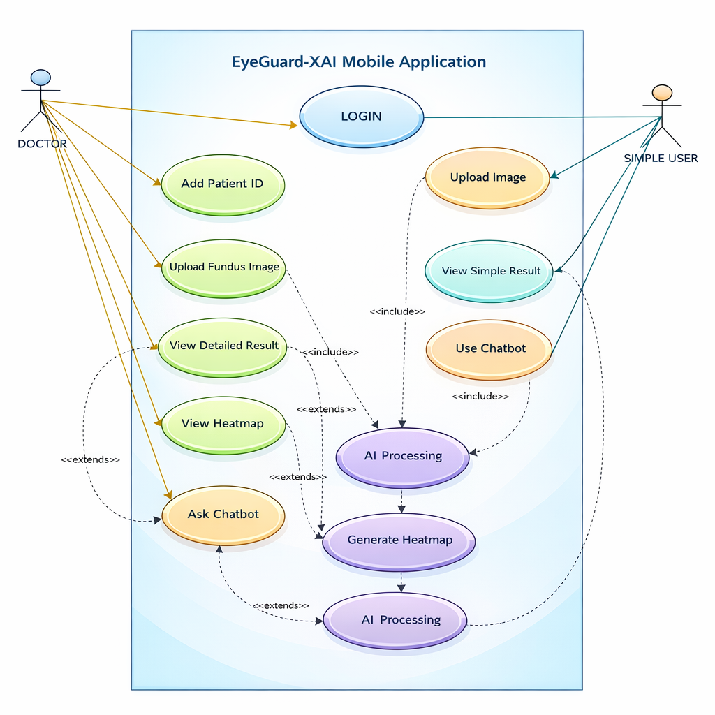
Use Case Diagram

Slide 7
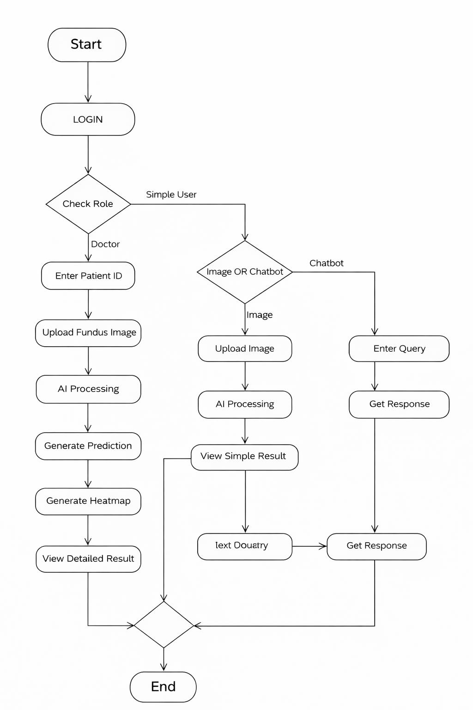
Activity Diagram

Slide 8
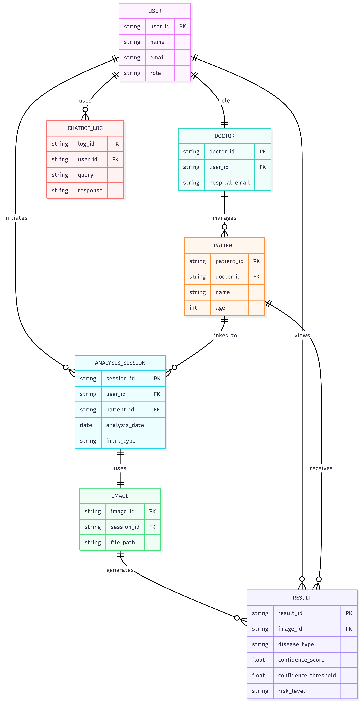
ER Diagram

Slide 9
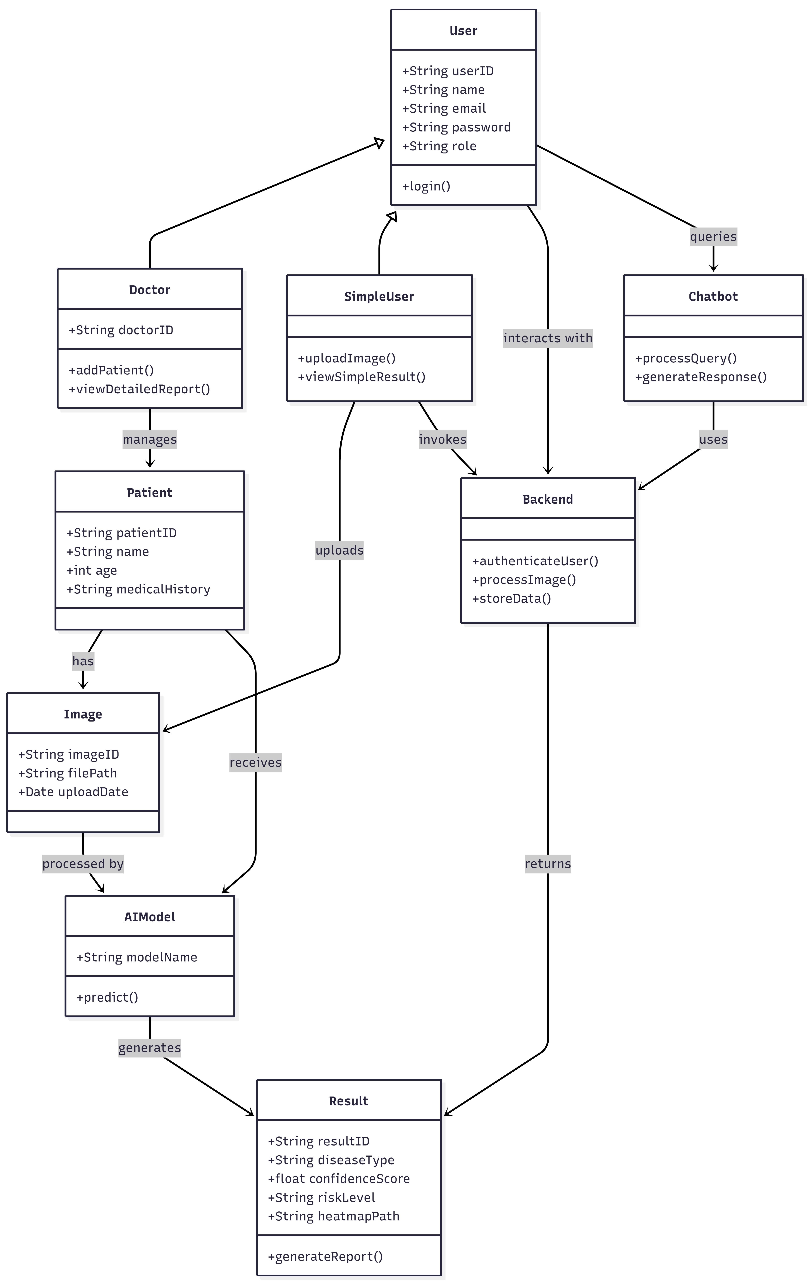
Class Diagram

Slide 10
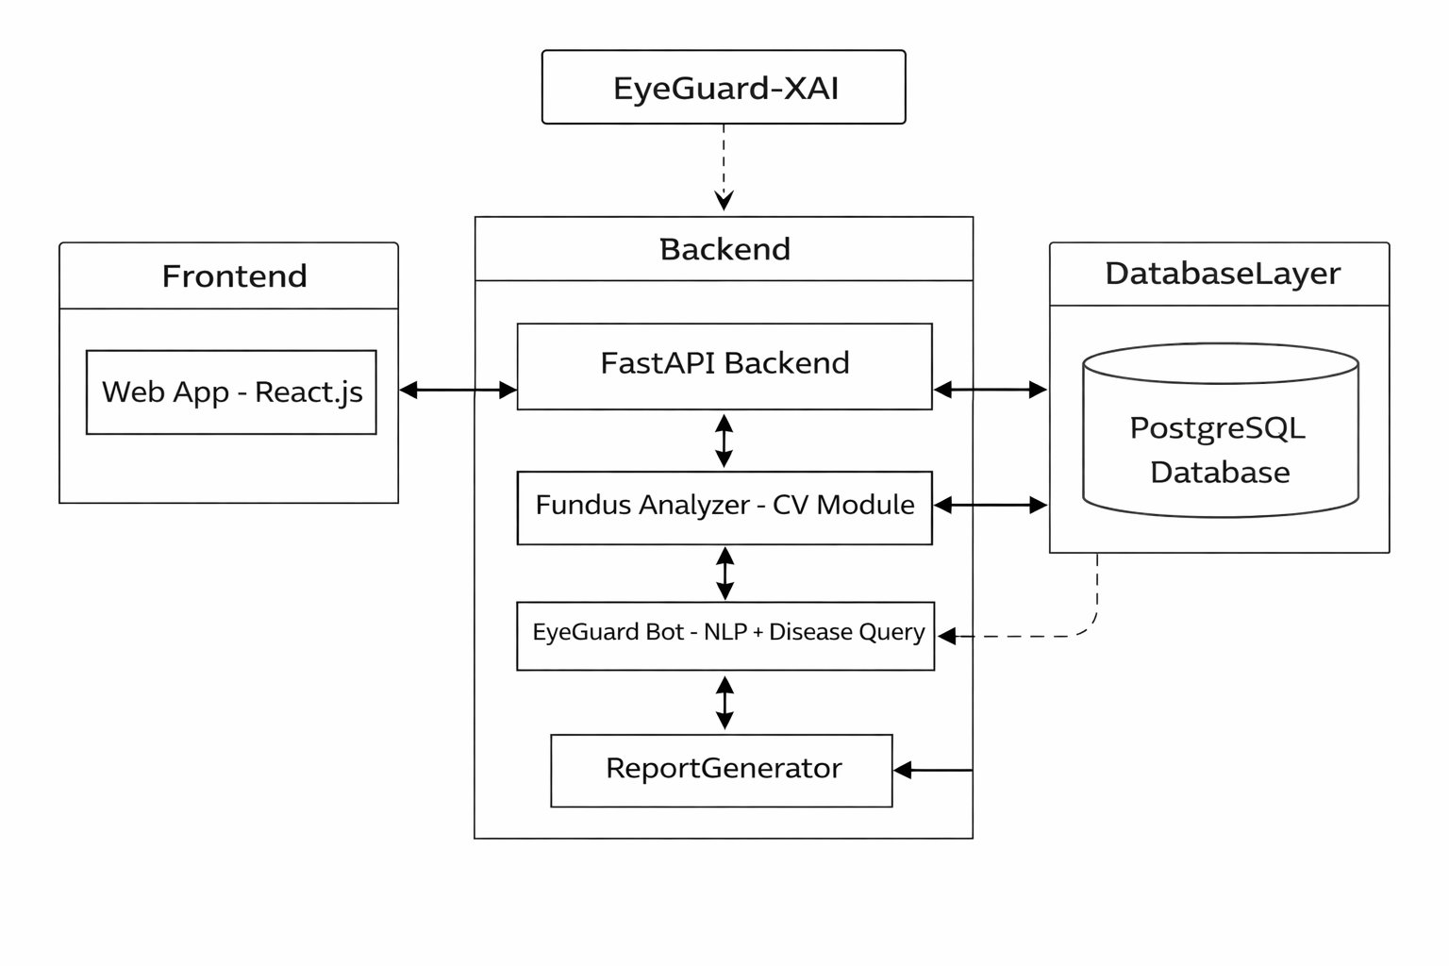
Component Diagram

Slide 11
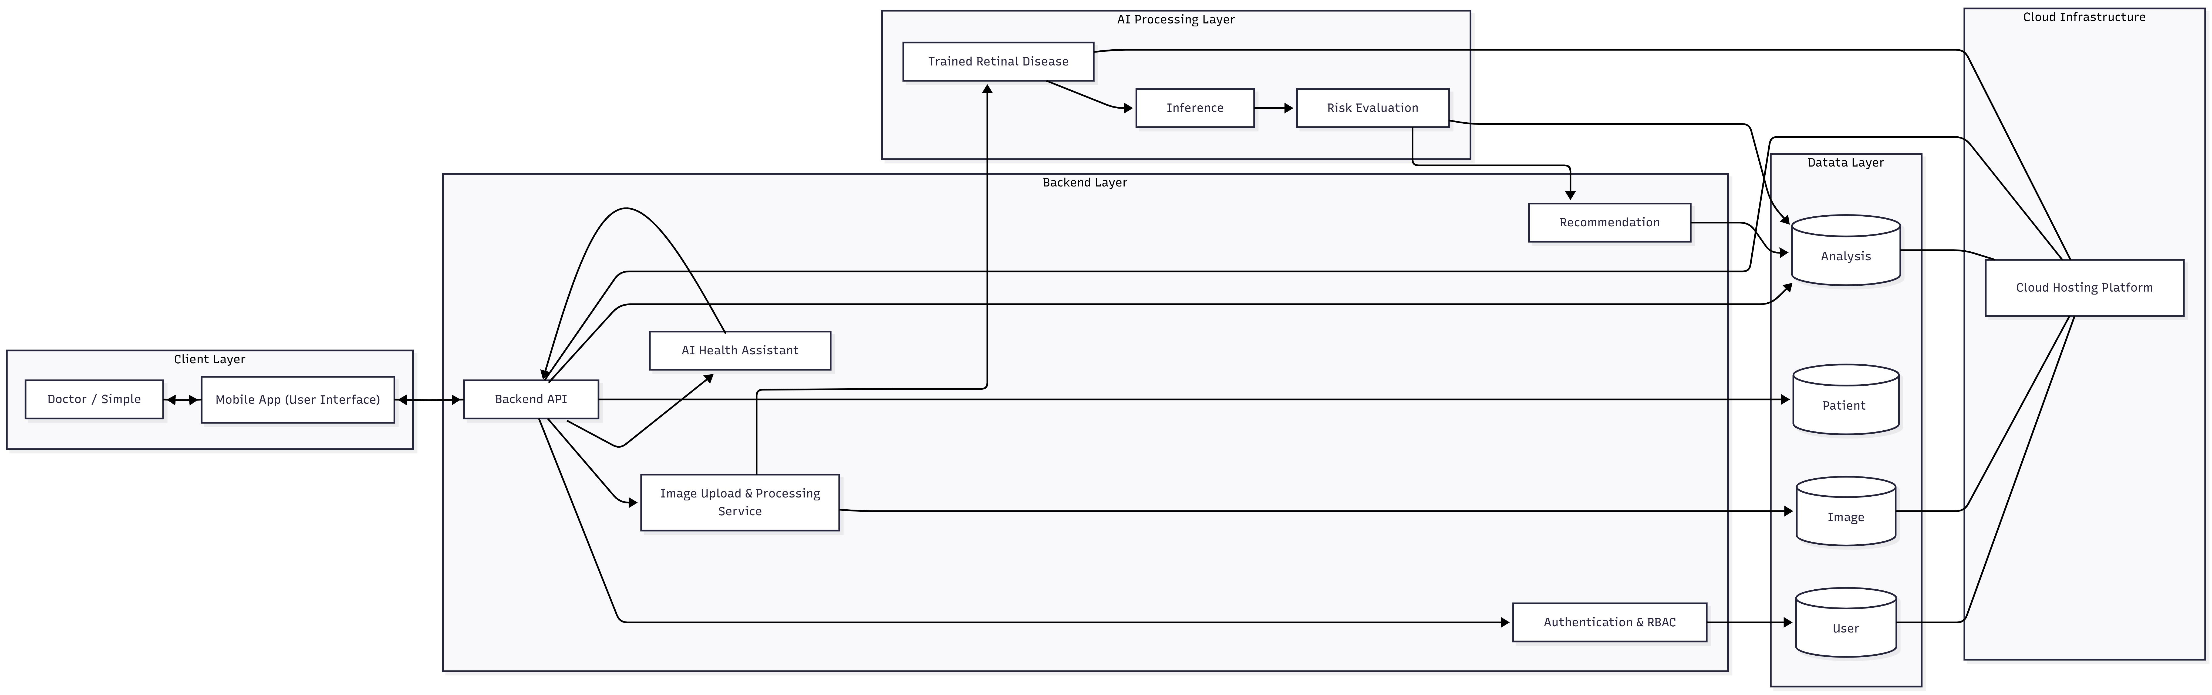
System Diagram

Slide 12
Sequence Diagram

Slide 13
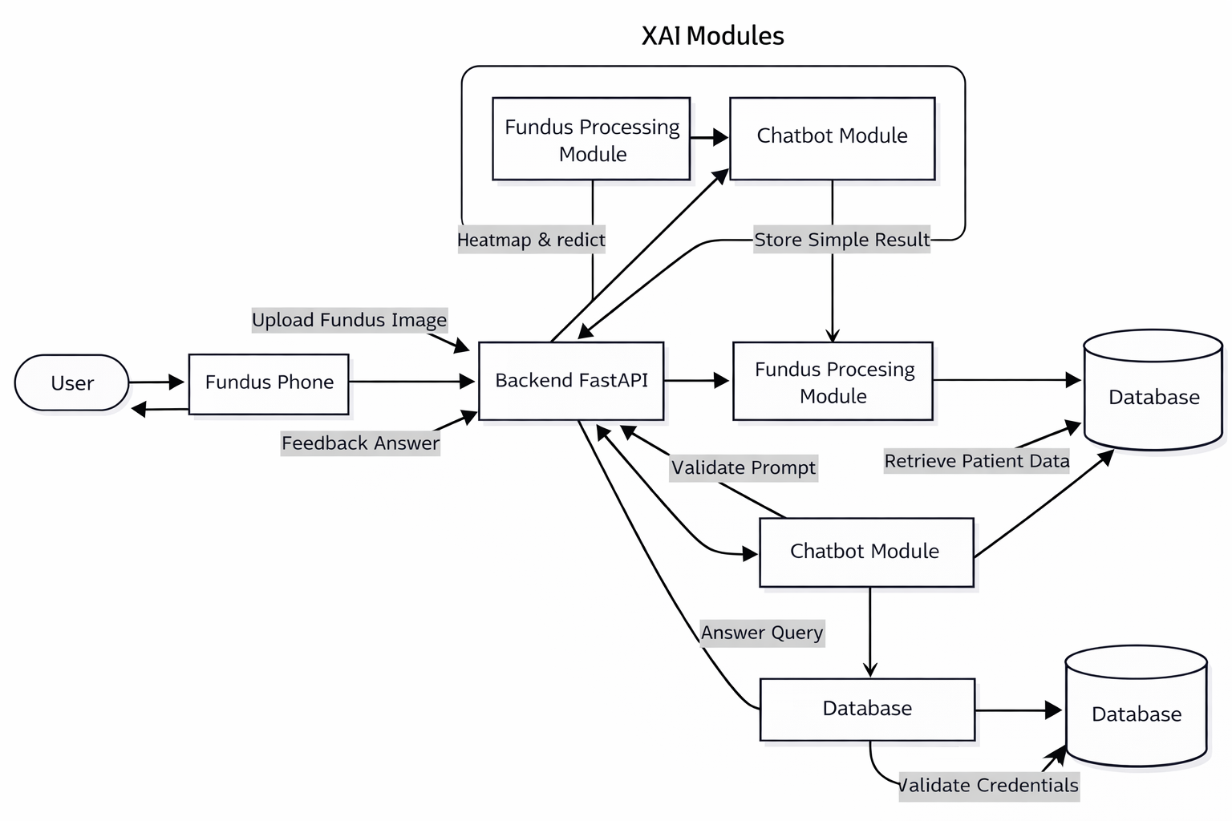
Flow Diagram

Slide 14
Datasets
EyePACS
https://www.kaggle.com/datasets/mariaherrerot/diabetic-retinopathy-preprocessed
https://www.kaggle.com/competitions/diabetic-retinopathy-detection
The EyePACS (Eye Picture Archive Communication System) Dataset is a large-scale collection of retinal fundus images used primarily for detecting diabetic retinopathy using machine learning and deep learning techniques..

Slide 15
Datasets
APTOS Dataset
https://www.kaggle.com/datasets/abdallahalidev/aptos-2019-blindness-detection
https://www.kaggle.com/competitions/aptos2019-blindness-detection
The APTOS (Asia Pacific Tele-Ophthalmology Society) Dataset is a collection of retinal fundus images used for detecting and grading diabetic retinopathy severity levels using machine learning models.

Slide 16
Datasets
ODIR Datasets
https://www.kaggle.com/datasets/andrewmvd/ocular-disease-recognition-odir5k
https://www.kaggle.com/datasets/andrewmvd/retinal-fundus-multi-disease-image-dataset-rfmid
The ODIR (Ocular Disease Intelligent Recognition) and RFMiD (Retinal Fundus Multi-Disease Image Dataset) are multi-disease retinal image datasets designed for detecting and classifying multiple eye conditions using deep learning models.

Slide 17
Datasets
Retinal Image Dataset
Custom retinal dataset: We collect retinal (eye) images from multiple sources, covering diverse patient demographics, varying image qualities, and multiple disease conditions to ensure robustness and generalization.
Image preprocessing & feature extraction: Images are processed using deep learning models (e.g., CNN-based architectures) to extract relevant visual features such as lesions, hemorrhages, and structural abnormalities.
Disease labeling: Each image is annotated with corresponding disease labels (e.g., diabetic retinopathy, glaucoma, normal) based on clinical reports and expert-defined diagnostic criteria.
Public datasets for augmentation: To improve model performance and generalization, publicly available datasets are incorporated. For example, EyePACS provides large-scale retinal images for diabetic retinopathy, while Messidor offers labeled fundus images for disease severity grading.

Slide 18
Expected Result
Accurate multi-disease detection.
Reliable predictions with uncertainty awareness.
Explainable outputs via heatmaps.
Improved trust for doctors and users.

Slide 19
Scope of the project
In-Scope:
AI-based retinal disease detection.
Explainability (Grad-CAM) and uncertainty estimation.
Dual-interface application.
Out-of-Scope:
Clinical diagnosis replacement.
Real-time hospital integration.

Slide 20
Goals
Develop a reliability-aware AI screening system.
Provide interpretable and explainable outputs.
Enhance trust in medical AI.
Support both clinical and general users.

Slide 21
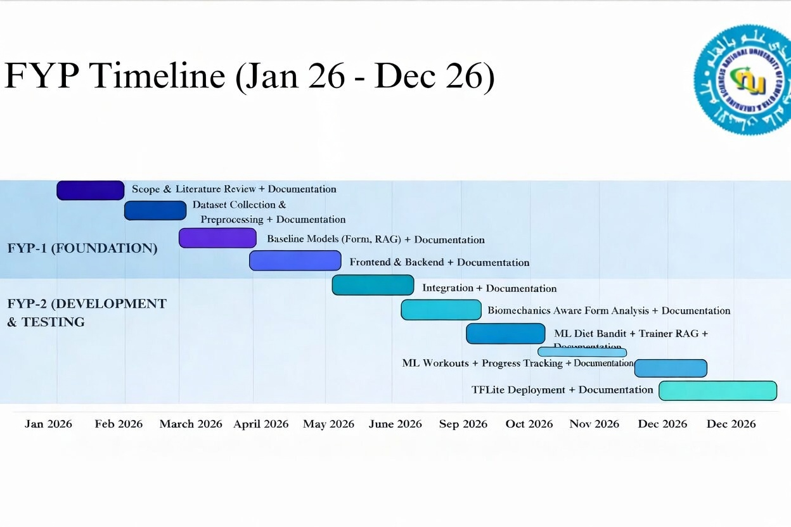
Objectives

Slide 22
Work Distribution
Talha Hanif
System Design & Architecture
AI Model Integration (Prediction + XAI)
Backend Development (FastAPI)
Database Design (ERD, Schema)
Model Evaluation & Testing
Muhammed Usman
Frontend Development (Mobile UI – React Native)
UI/UX Design (User Flow, Screens)
Integration with Backend APIs
Chatbot Interface Implementation
Presentation & Documentation Support

Slide 23
References
[1] Y. Gal and Z. Ghahramani, “Dropout as a Bayesian approximation: Representing model uncertainty in deep learning,” in Proc. Int. Conf. Machine Learning (ICML), 2016, pp. 1050–1059.
[2] A. Kendall and Y. Gal, “What uncertainties do we need in Bayesian deep learning for computer vision?,” in Advances in Neural Information Processing Systems (NeurIPS), 2017.
[3] C. Guo, G. Pleiss, Y. Sun, and K. Q. Weinberger, “On calibration of modern neural networks,” in Proc. Int. Conf. Machine Learning (ICML), 2017.
[4] R. R. Selvaraju et al., “Grad-CAM: Visual explanations from deep networks via gradient-based localization,” in Proc. IEEE Int. Conf. Computer Vision (ICCV), 2017.
[5] S. Tjoa and C. Guan, “A survey on explainable artificial intelligence (XAI): Toward medical XAI,” IEEE Trans. Neural Netw. Learn. Syst., 2020.
[6] K. He, X. Zhang, S. Ren, and J. Sun, “Deep residual learning for image recognition,” in Proc. IEEE Conf. Computer Vision and Pattern Recognition (CVPR), 2016.
[7] O. Russakovsky et al., “ImageNet large scale visual recognition challenge,” Int. J. Comput. Vision, vol. 115, no. 3, pp. 211–252, 2015.
[8] D. Chicco and G. Jurman, “The advantages of the Matthews correlation coefficient (MCC) over F1 score and accuracy in binary classification evaluation,” BMC Genomics, vol. 21, 2020.

Slide 24
References
[9] J. Caruana et al., “Intelligible models for healthcare: Predicting pneumonia risk and hospital readmission,” in Proc. ACM SIGKDD, 2015.
[10] J. Kermany et al., “Identifying medical diagnoses and treatable diseases by image-based deep learning,” Cell, vol. 172, no. 5, pp. 1122–1131, 2018.
[11] A. Esteva et al., “Dermatologist-level classification of skin cancer with deep neural networks,” Nature, vol. 542, pp. 115–118, 2017.
[12] World Health Organization, “Global health estimates and disease burden,” 2024. [Online]. Available: https://www.who.int/
[13] National Institutes of Health (NIH), “Medical imaging datasets and research resources,” 2023. [Online]. Available: https://www.nih.gov/
[14] A. Holzinger et al., “What do we need to build explainable AI systems for the medical domain?,” arXiv preprint arXiv:1712.09923, 2017.
[15] D. Rudin, “Stop explaining black box machine learning models for high stakes decisions and use interpretable models instead,” Nature Machine Intelligence, vol. 1, 2019.
[16] Z. Azam, personal communication, Medical Specialist / Consultant, Pakistan, 2025.

